Slide 1
Science Primary Capital in action at RTS

Slide 2
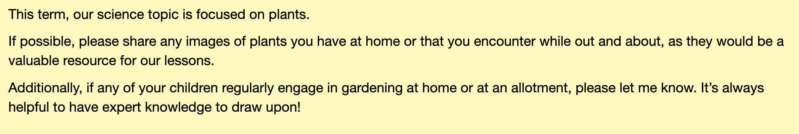
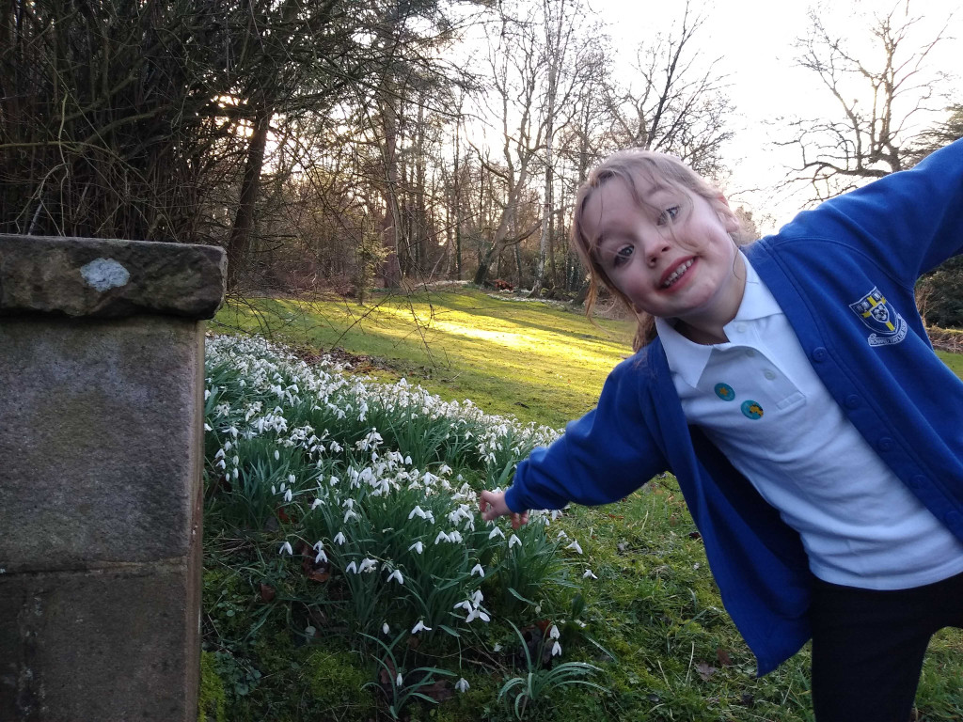
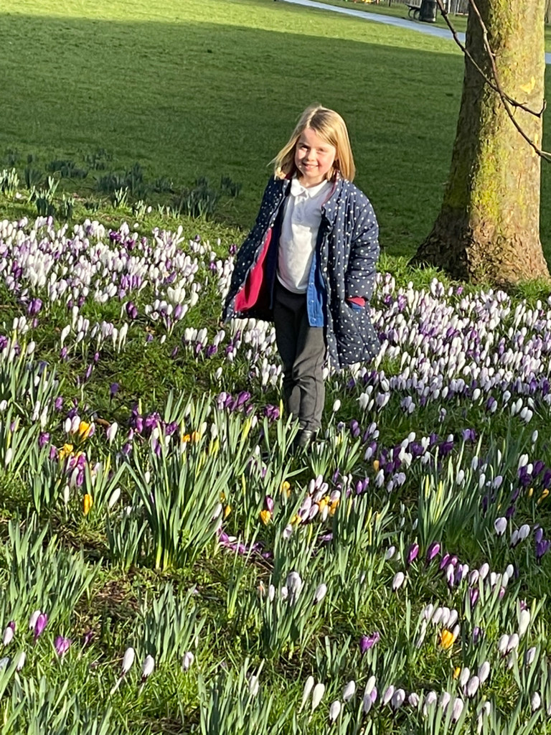
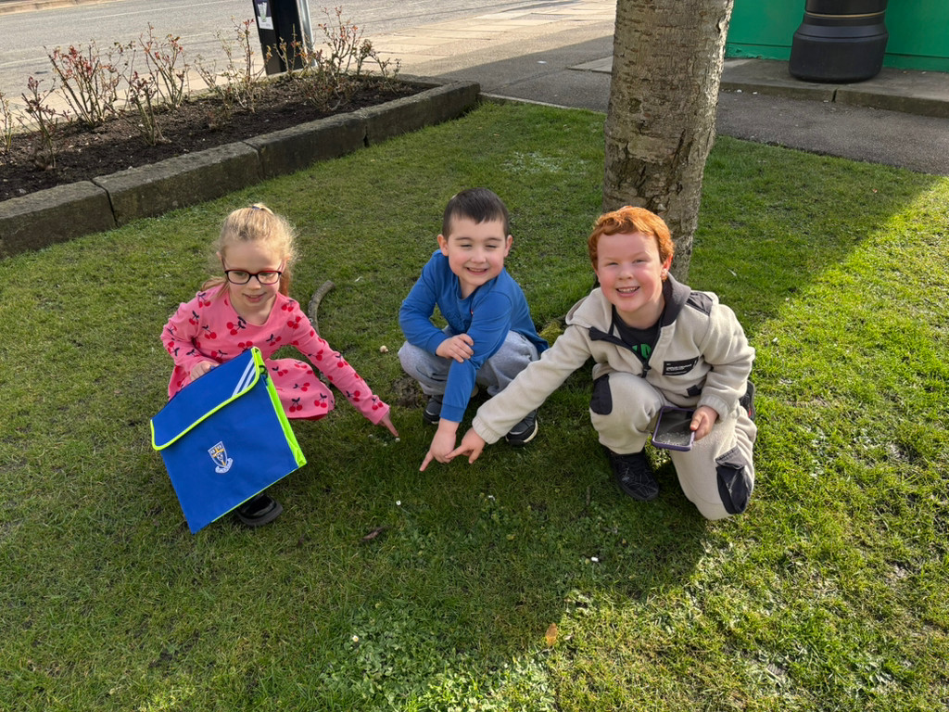
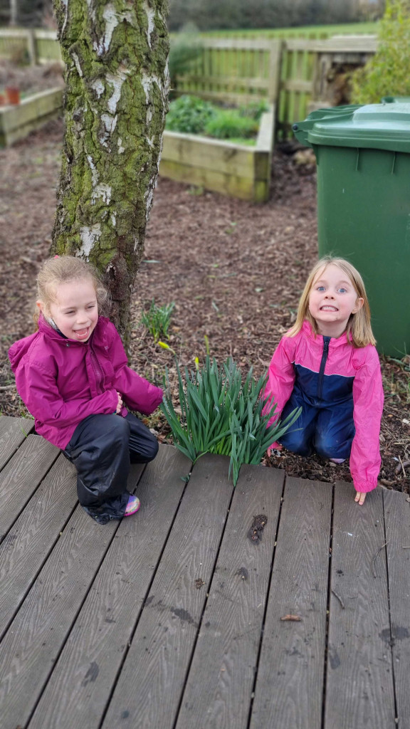
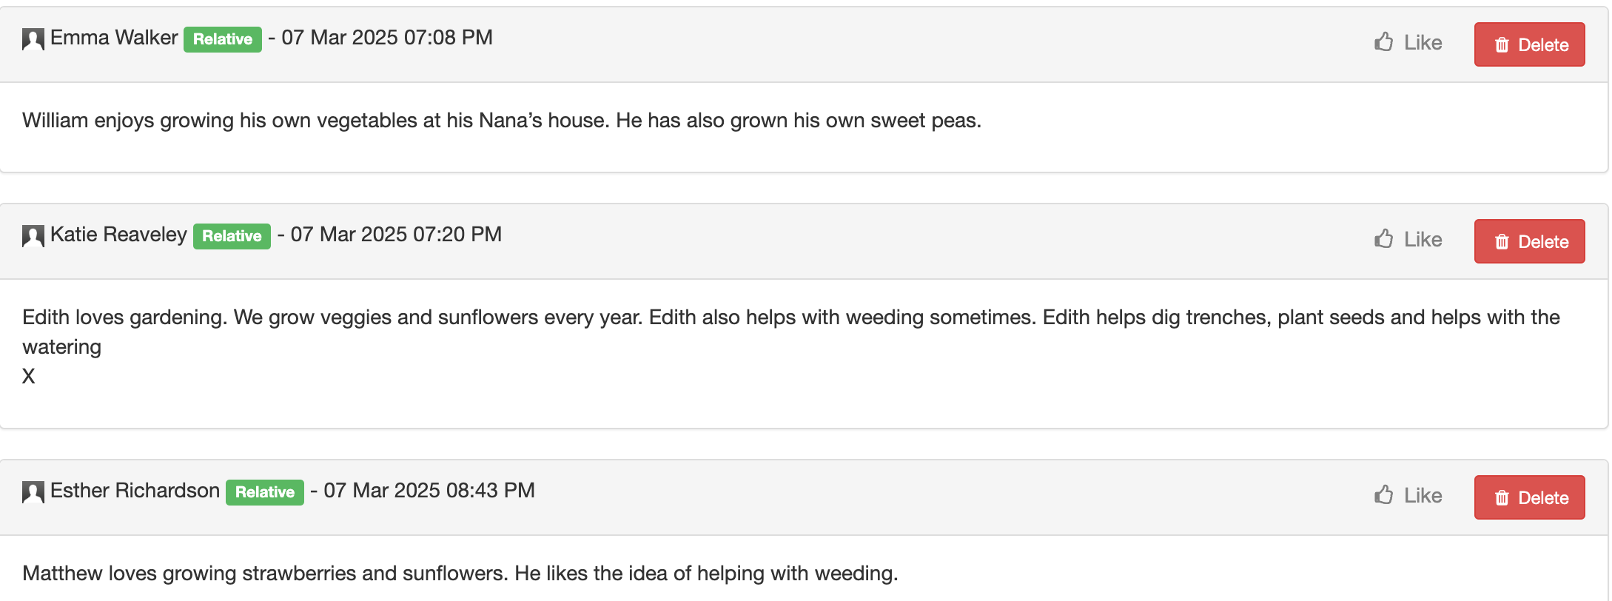
Airedale Class
Starting with the child: Our pre-topic task.
Using the children’s pictures in worksheets.
Fostering inclusive teaching and learning: A school grounds walk to find plants to give everyone the same experience.
Notes:
To complete after Session #1 Bedrock and Foundation of PSCTA
Paste a copy of a tweaked lesson plan that you have taught – annotate the plan to reflect on your approach and the impact on your pupils.

Slide 3
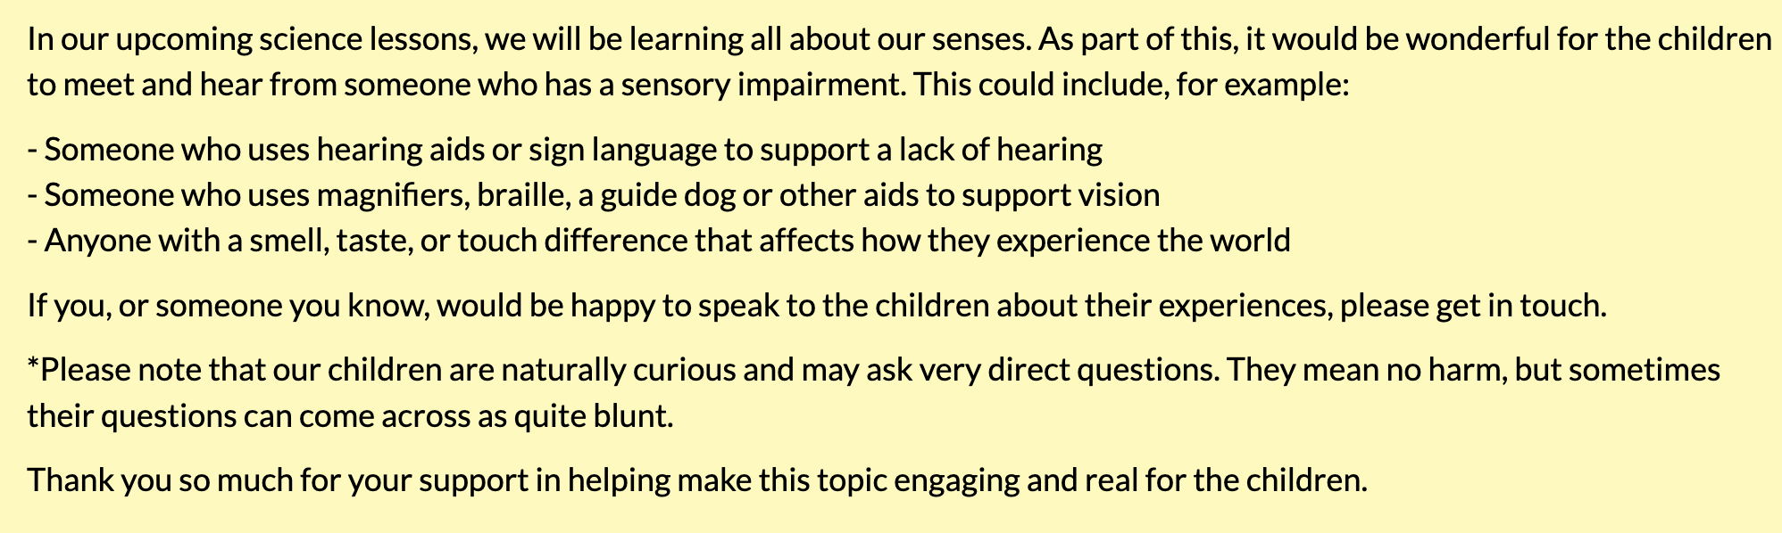
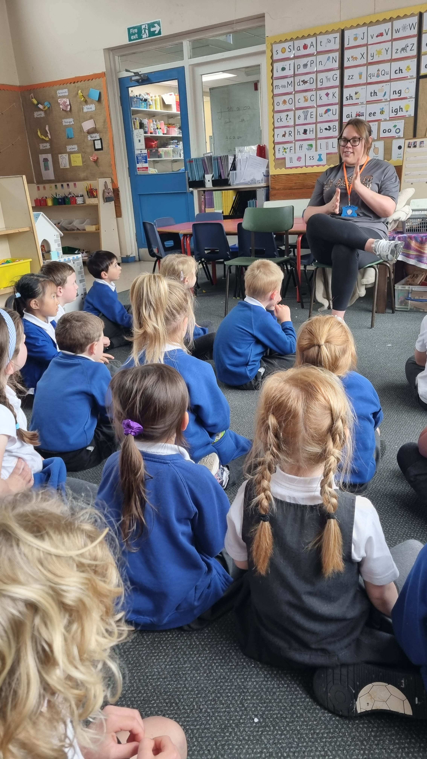
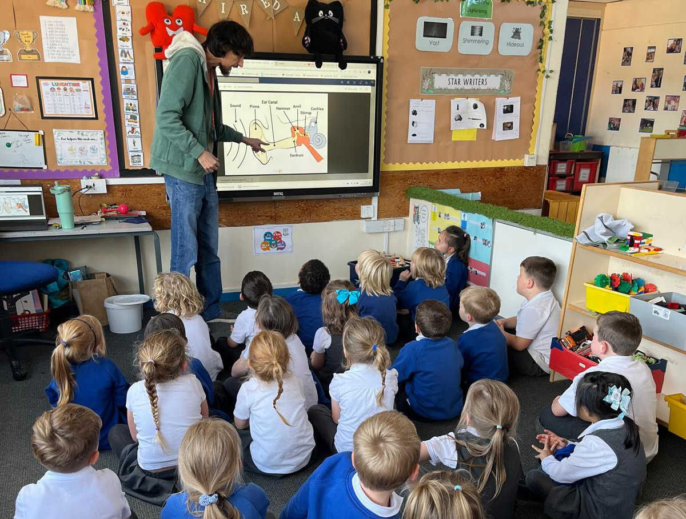
Airedale Class
Science capital Our pre-topic task.
Our first visitor spoke about growing up with deaf parents and taught us how she communicated through BSL.
Our second visitor talked to us all about why his ears don’t work like other people’s, discussed how hearing aids helped him and even let us take a look inside his hearing aid!

Slide 4
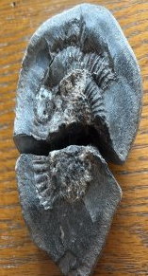
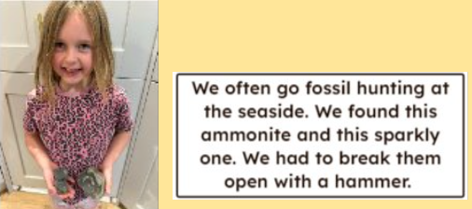
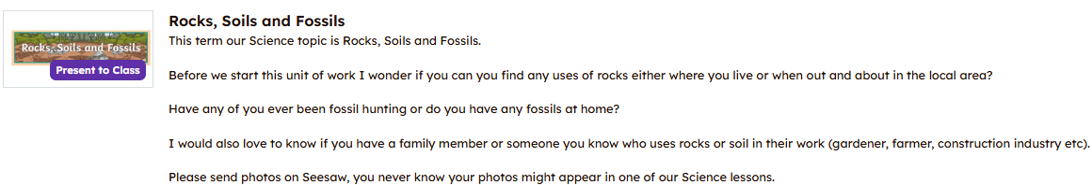
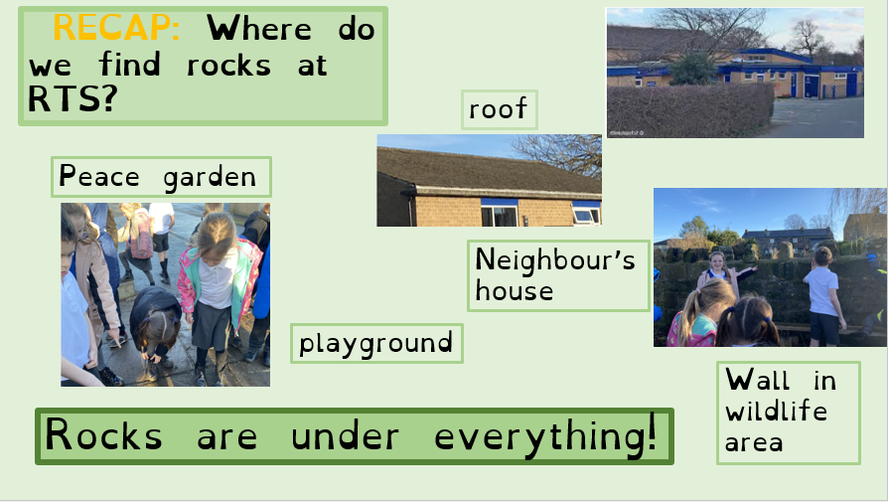
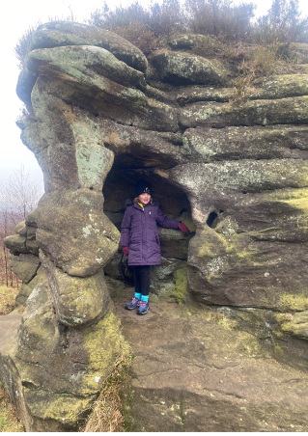
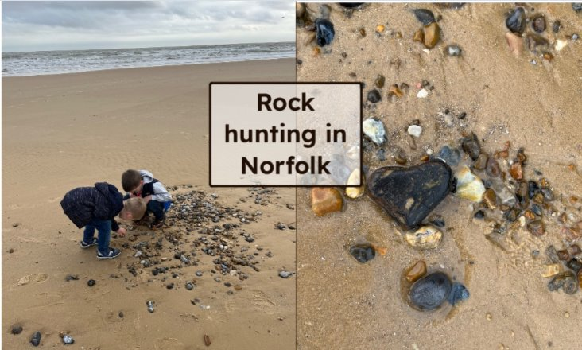
Swaledale class
Starting with the child to learn more about any prior knowledge/interests.
Pre topic task
Fostering inclusive teaching and learning –shared experience to find use of rocks at RTS.

Slide 5
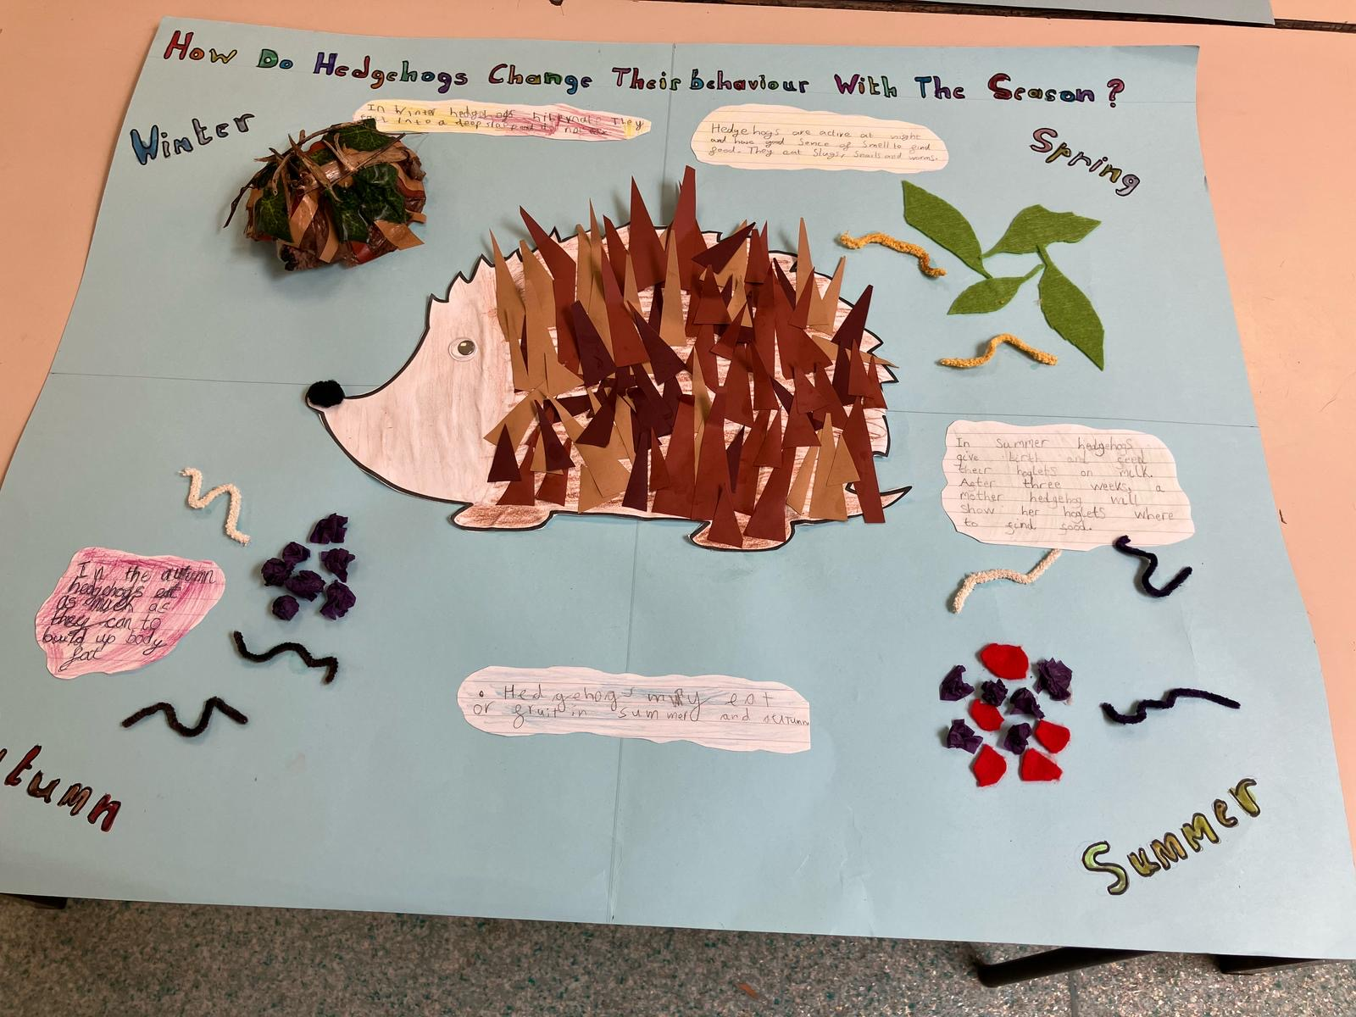
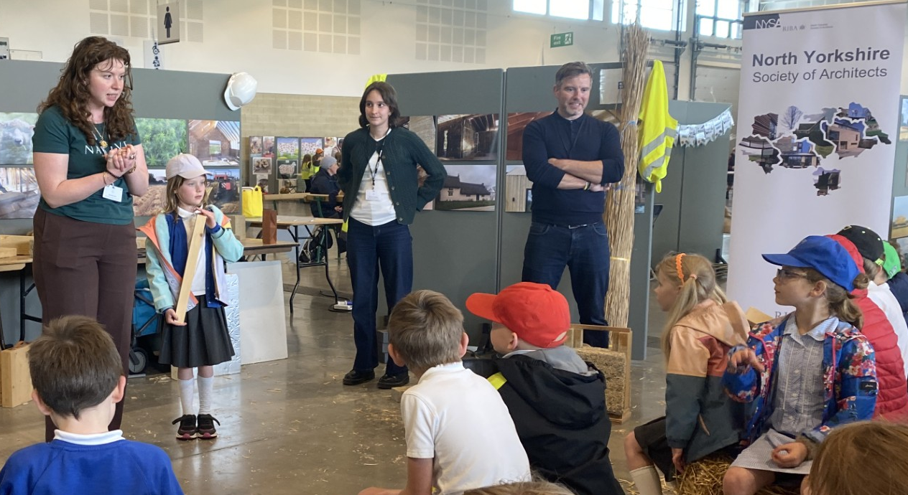
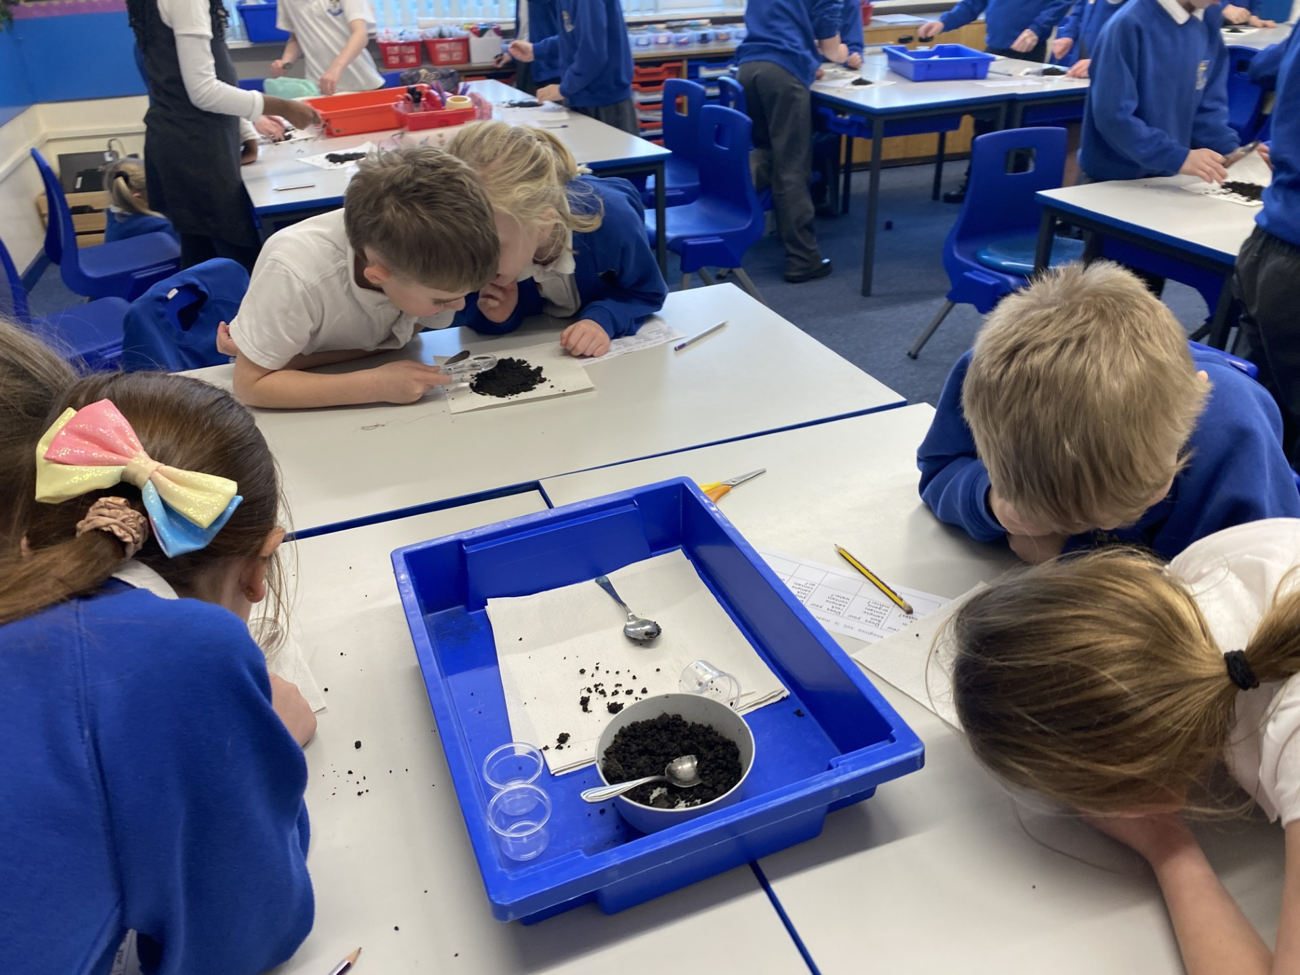
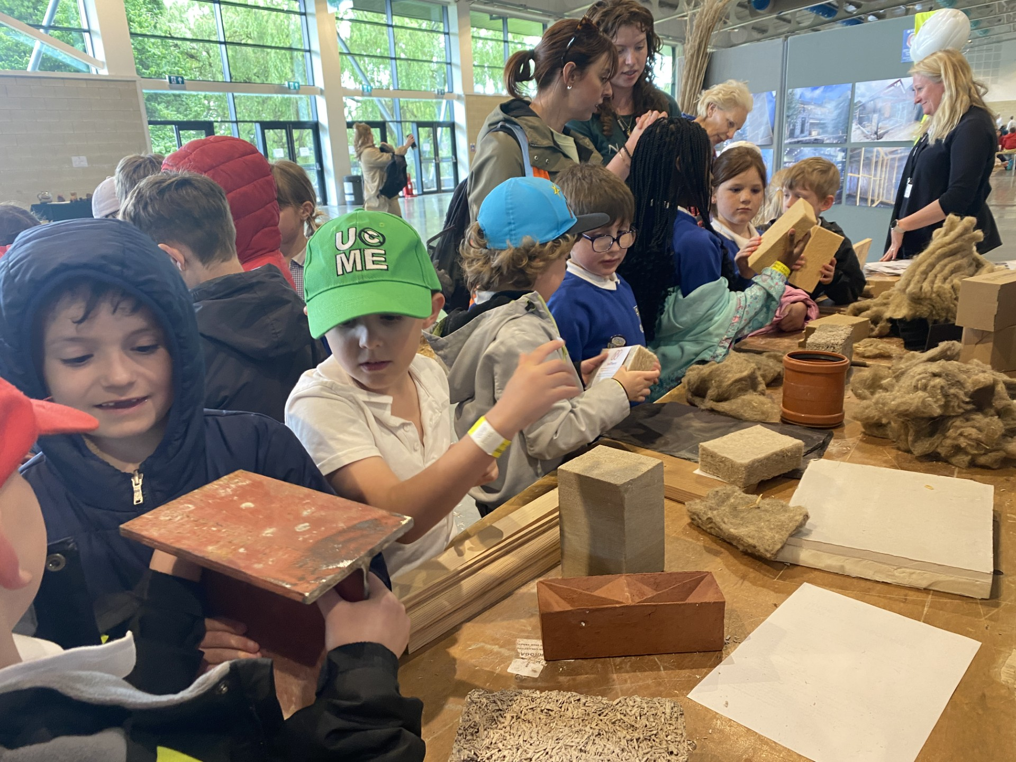
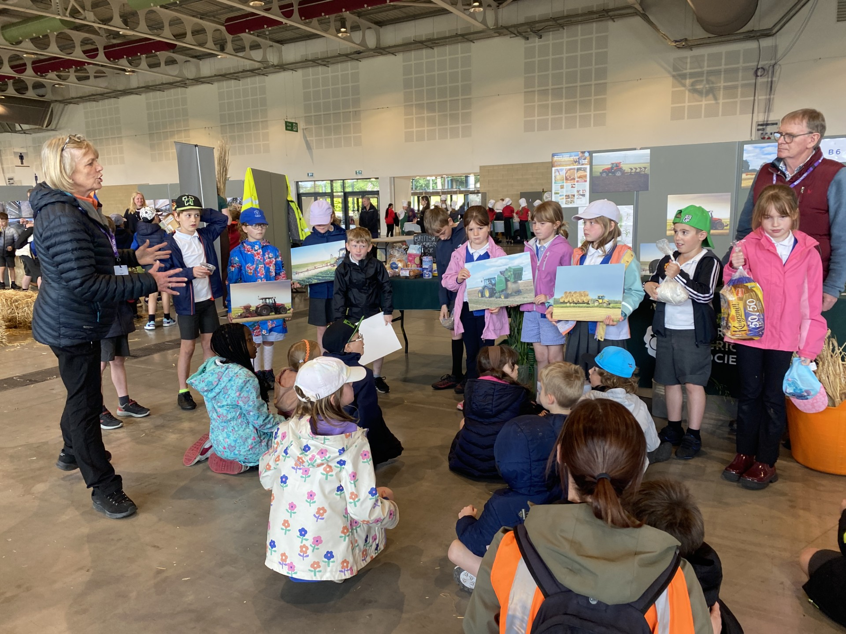
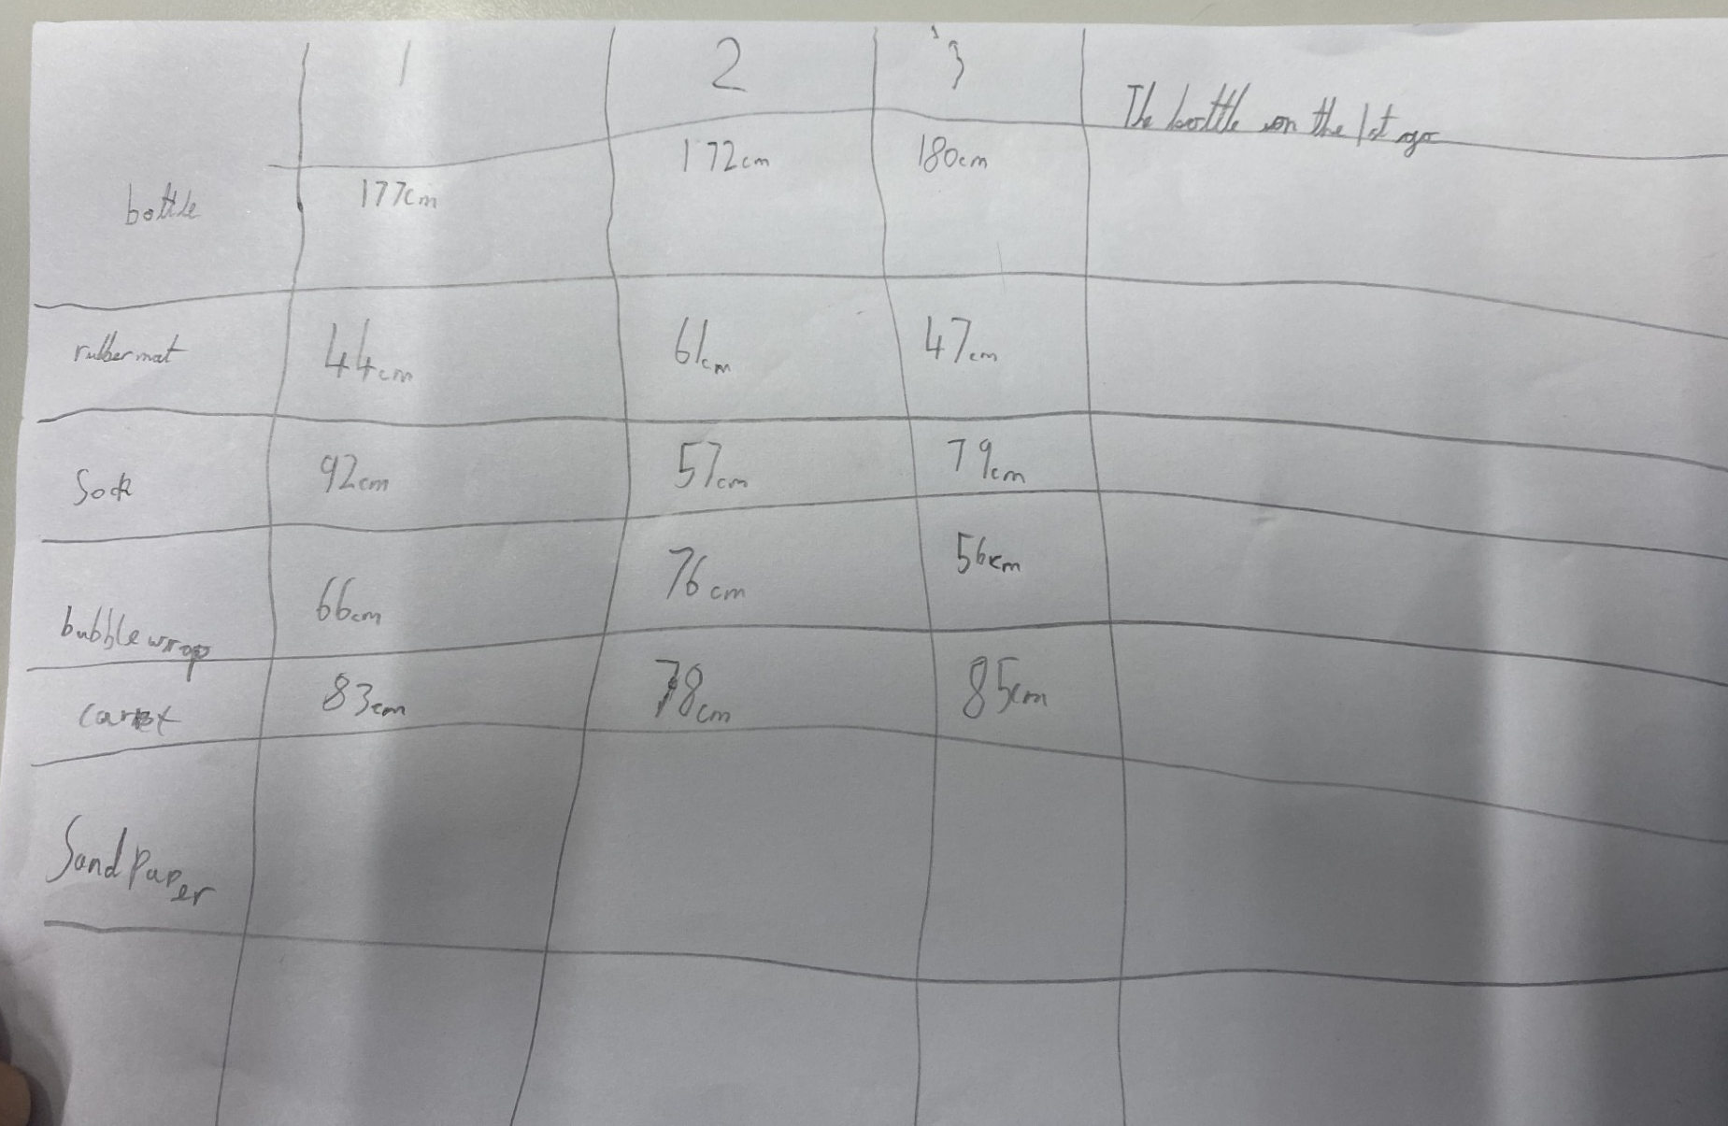
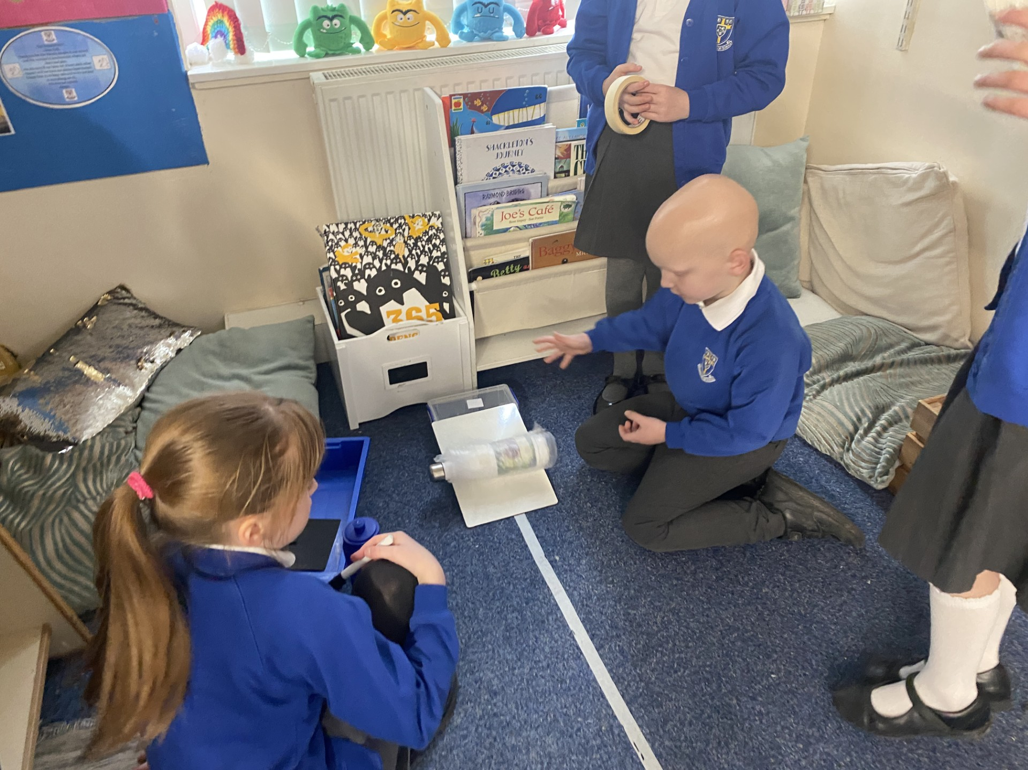
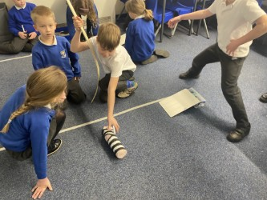
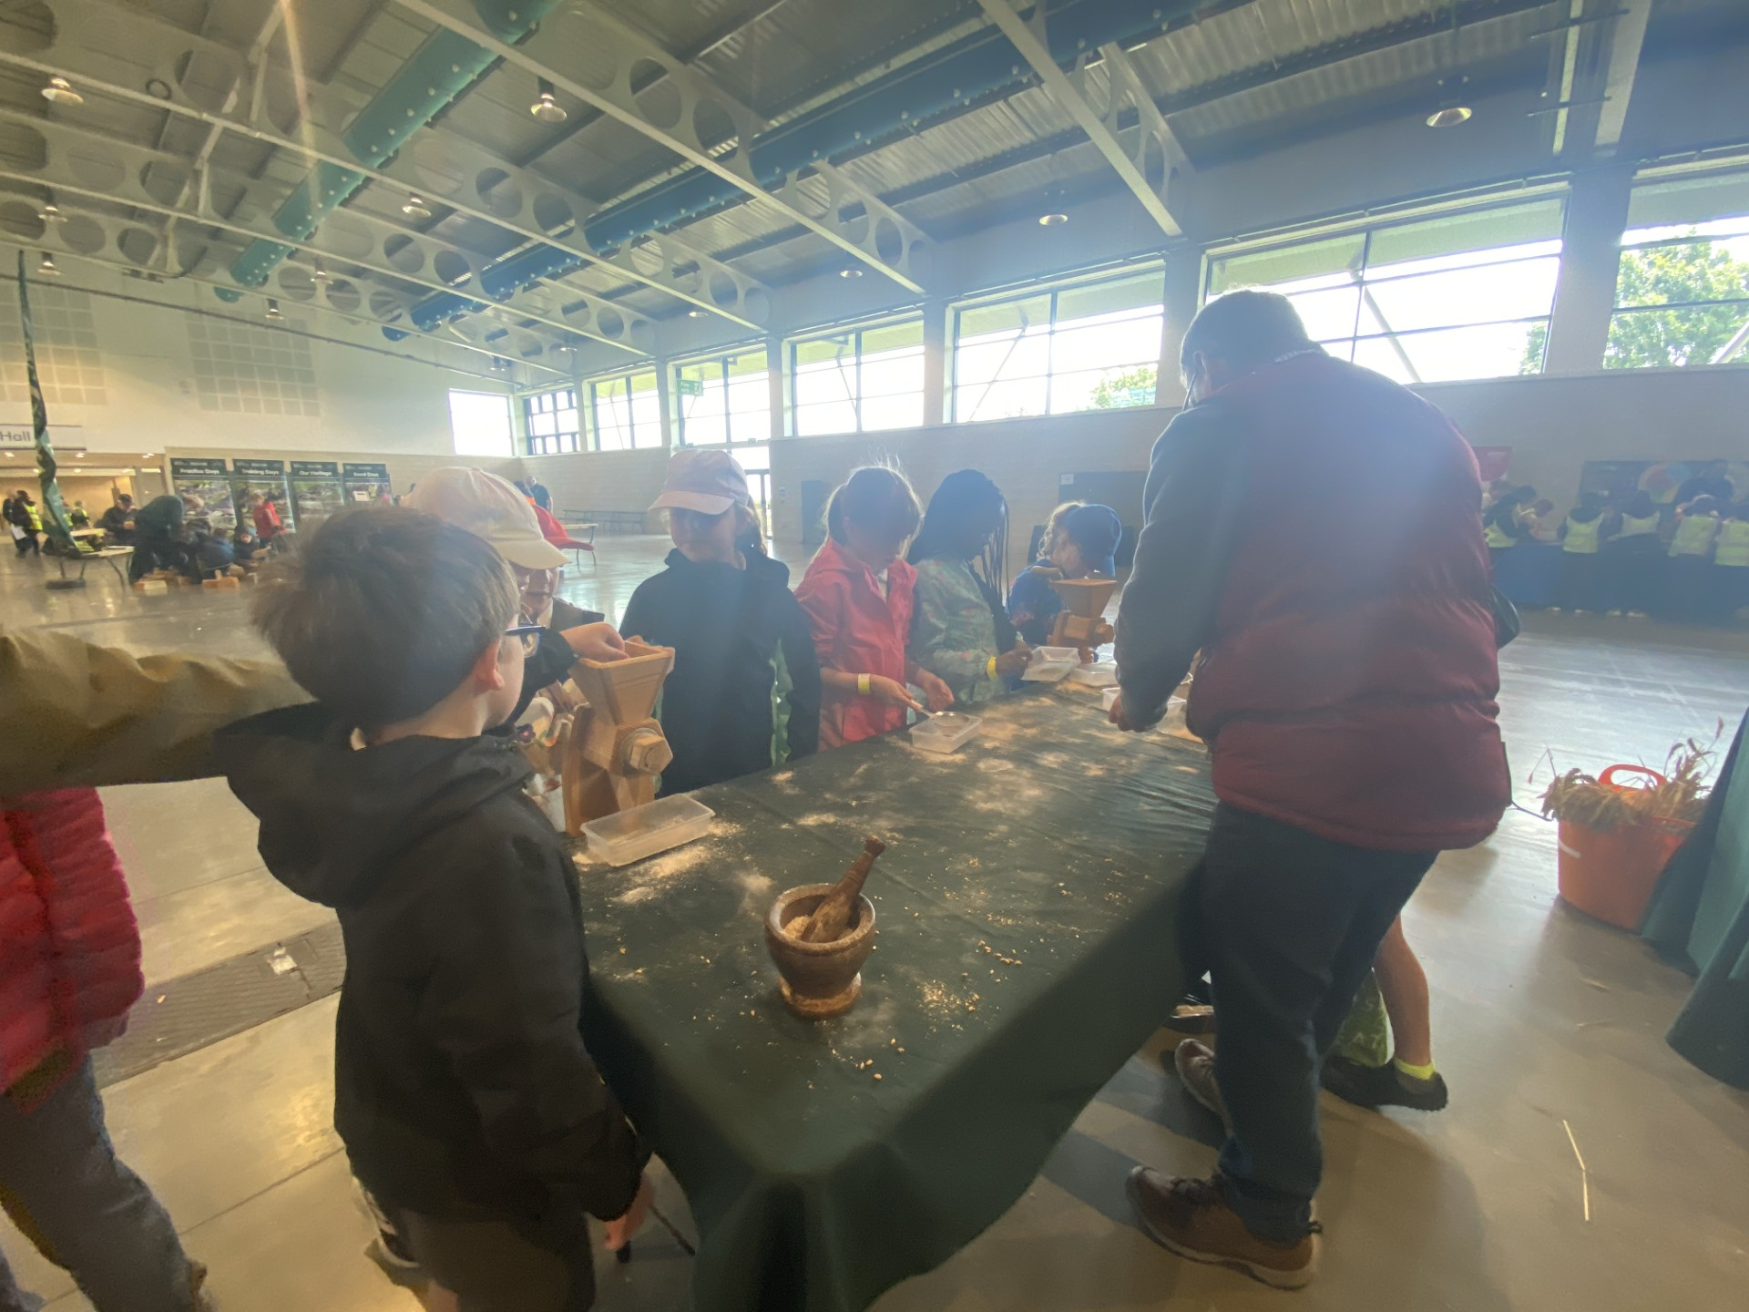
Swaledale Class
Personalising and Localising making learning relevant to the children’s lives and making it equitable by providing shared experiences
Countryside Day
Planning opportunities to develop Science Capital –Links made between science learning and real life careers through trips.
Supporting student voice – giving children increased ownership over their learning. Encouraging them to work scientifically as a team during an enquiry
Meeting architects
Collecting soil from school grounds to investigate
Meeting Farmers
British Science week PSTT investigation

Slide 6
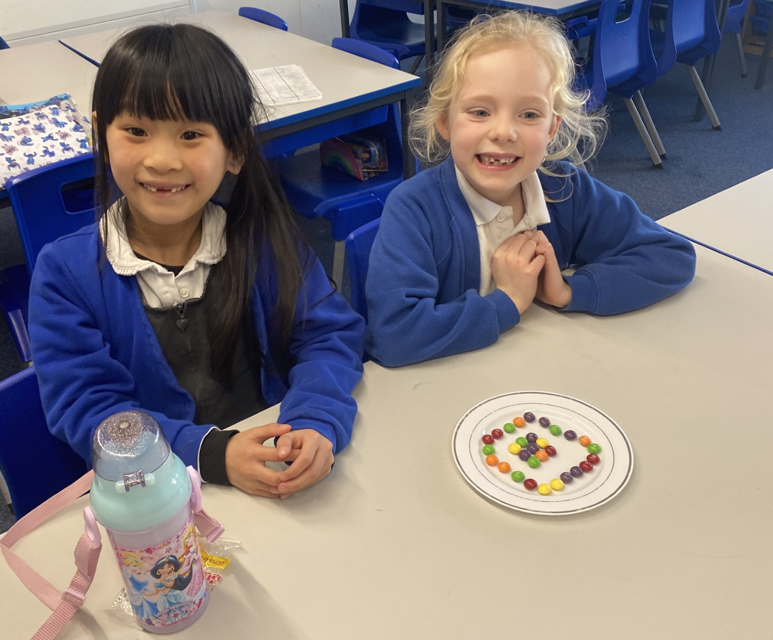
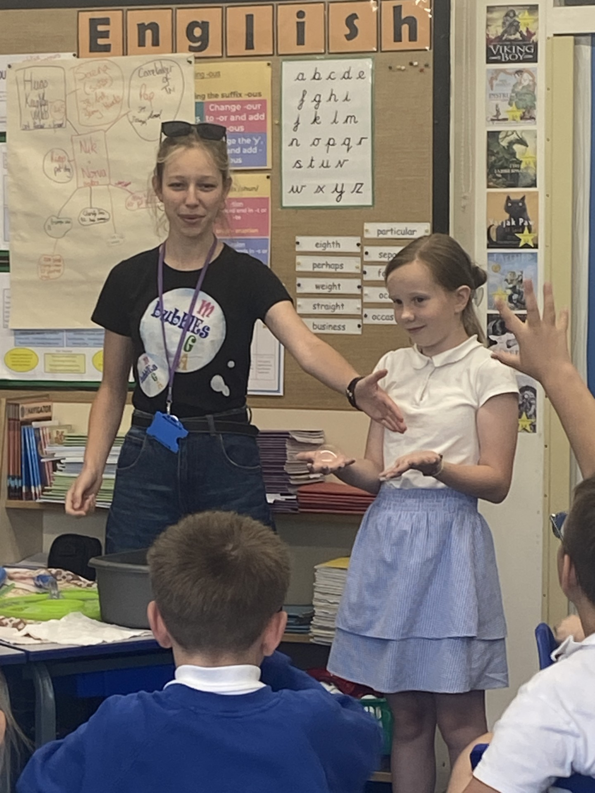
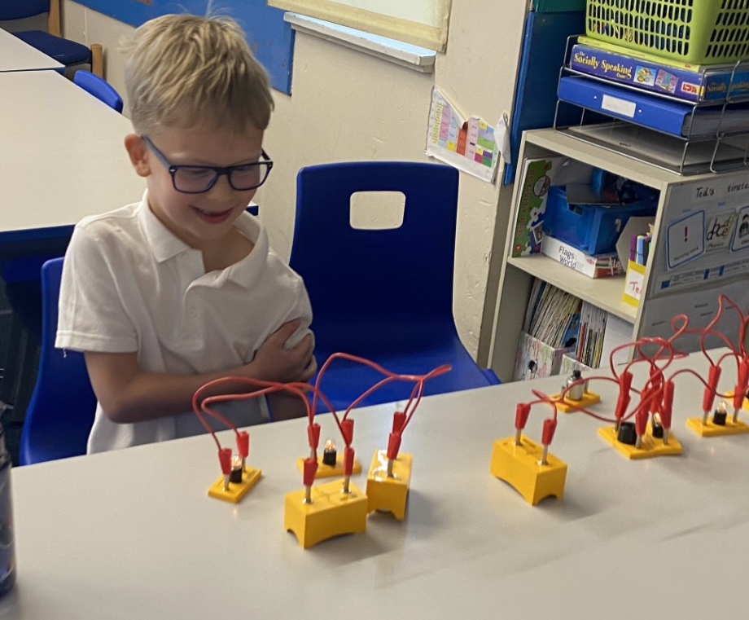
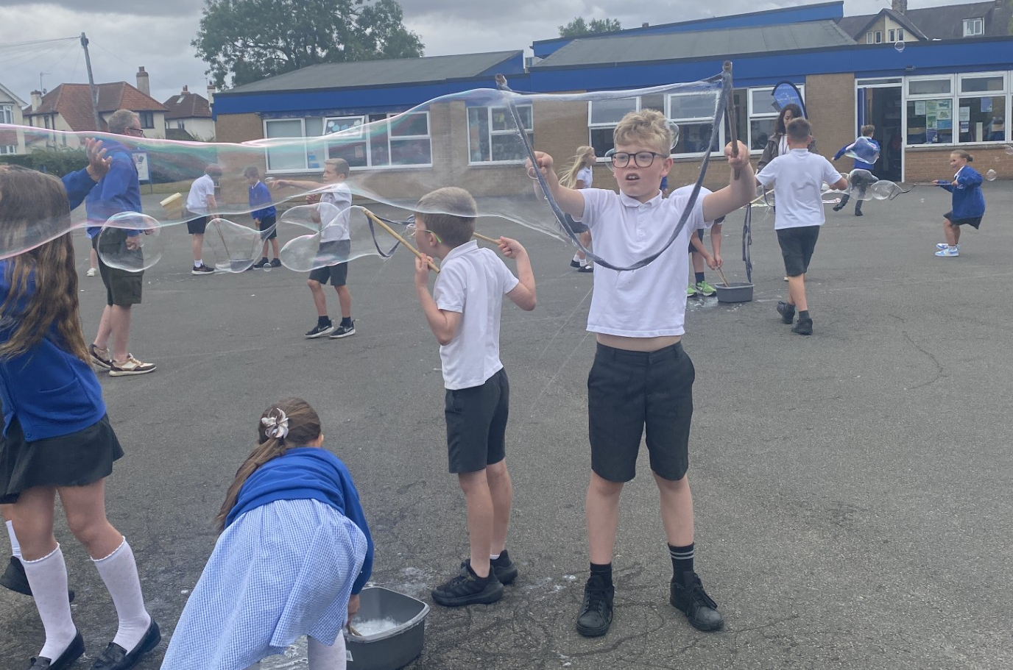
Examples of Enrichment opportunities during the PSCTA securing year
Yr2 Science club – giving pupils a voice encouraging questioning and curiosity and fostering a love of Science. Inclusive to all
Adapted medium term plans include links with a scientist/career and opportunities to develop science capital.
Science on Stage Links - visitors from Slovakia exploring Scientific concepts with year 4/5 children.
Notes:
Pupil voice, photos, pupils work etc

Slide 7
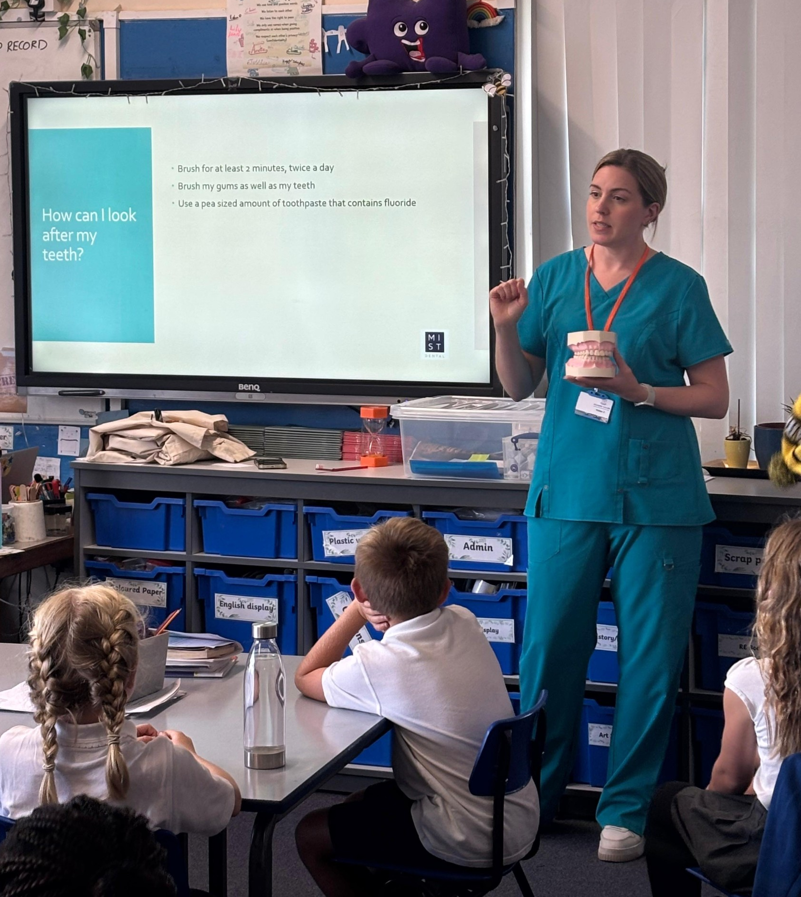
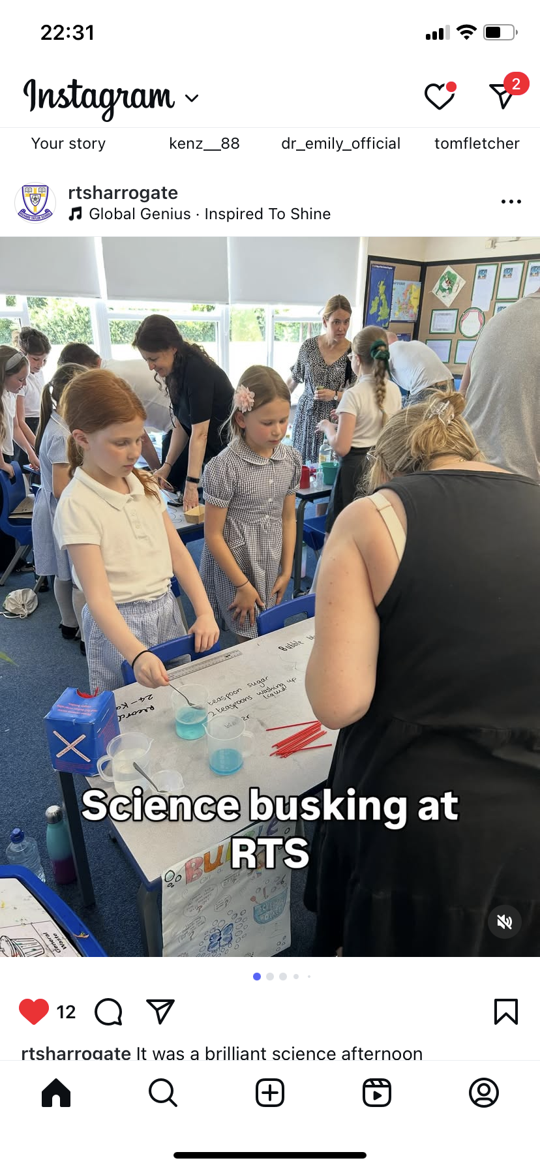
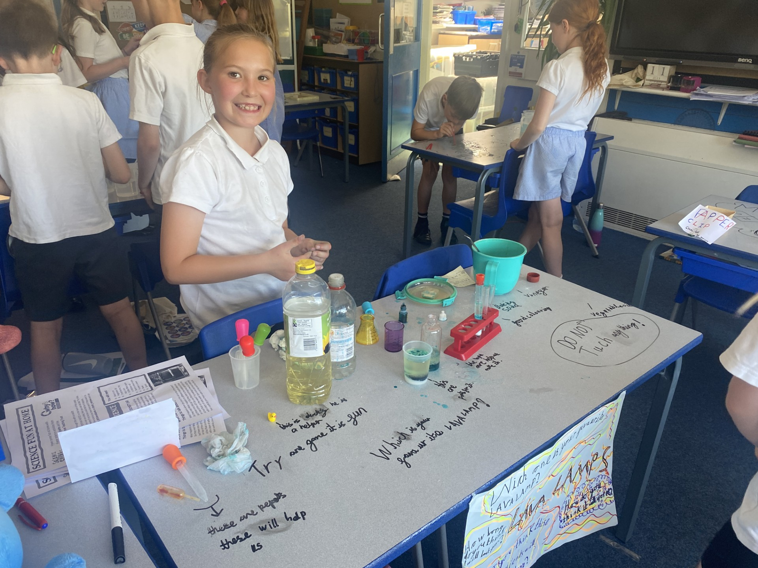
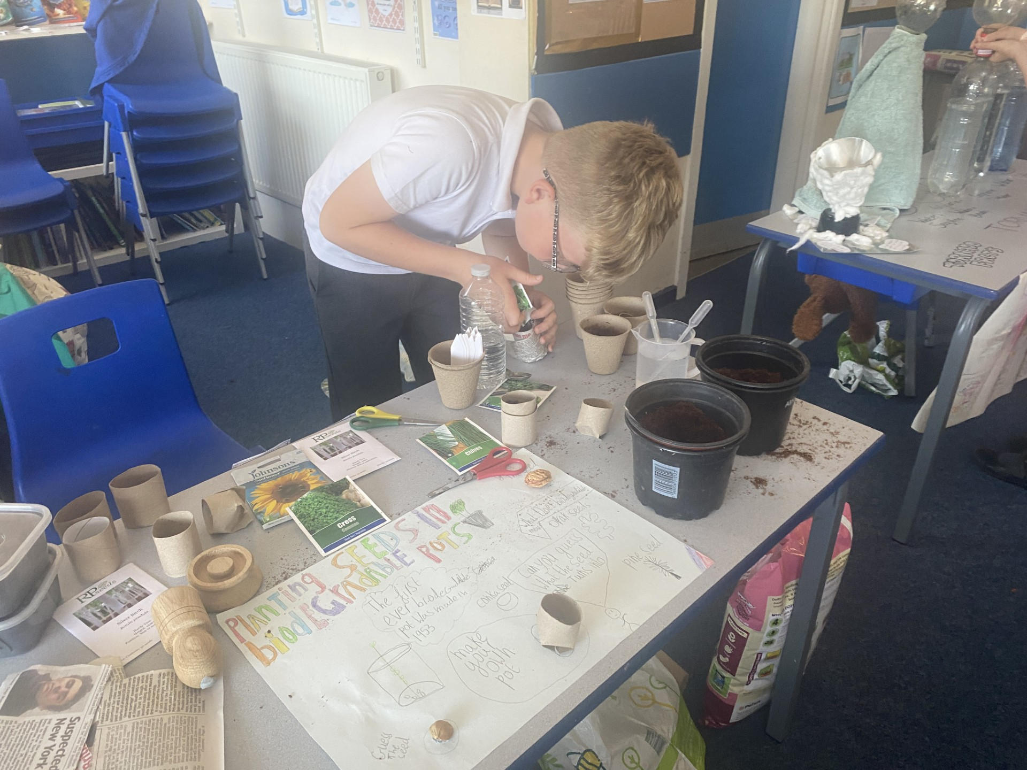
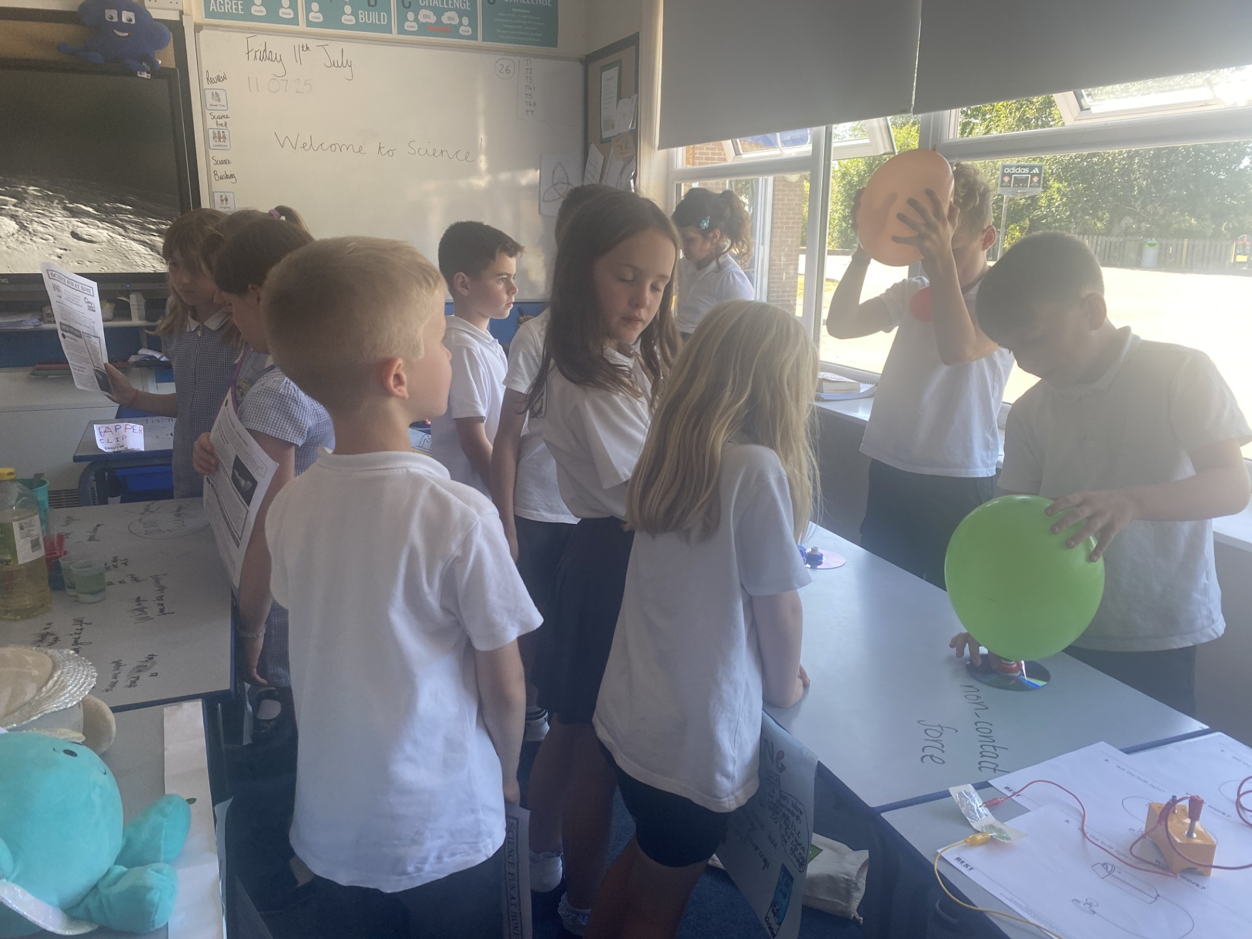
Raising the profile of Science using online platform.
Science Busking - Getting Science talked about more at home and engaging parents.
Making explicit links to real life jobs making learning meaningful and purposeful.
Science Busking – Giving pupils a voice
Notes:
Pupil voice, photos, pupils work etc

Slide 8
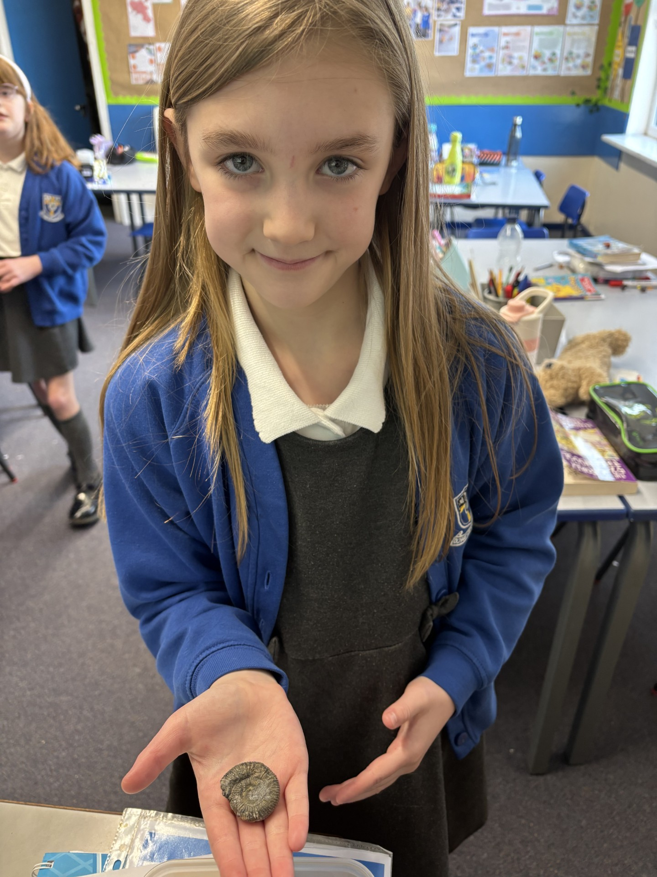
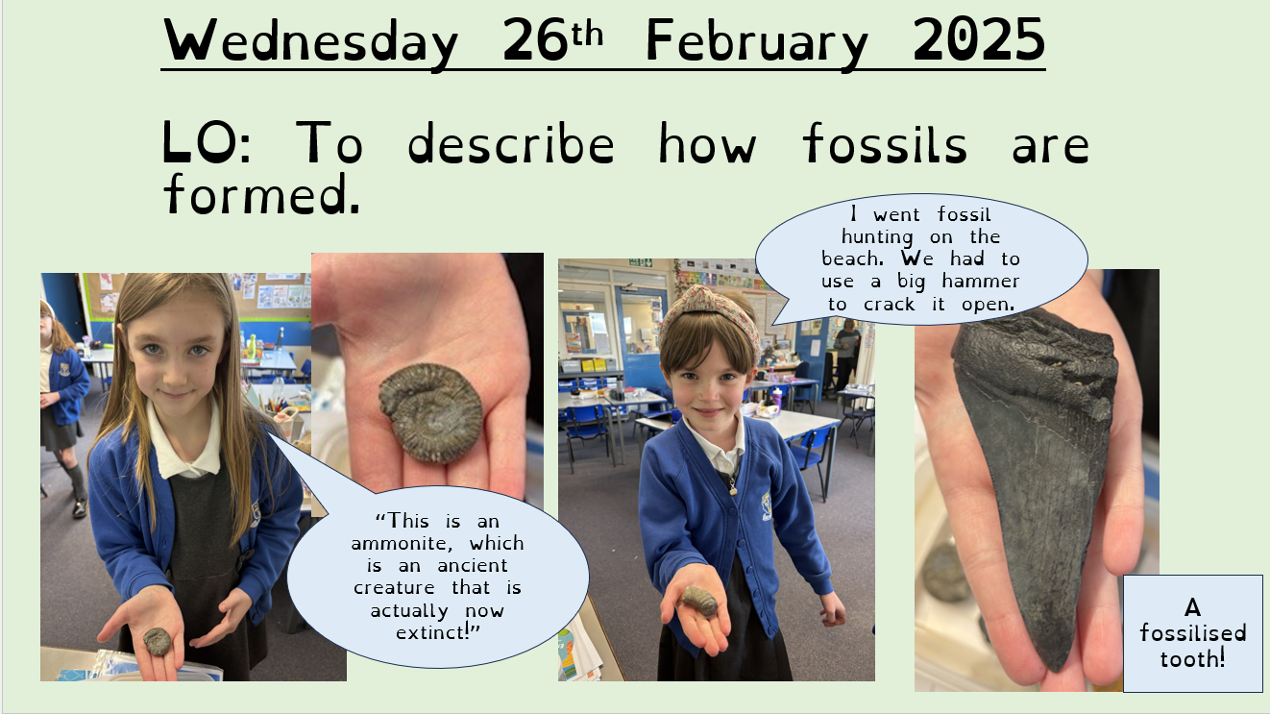
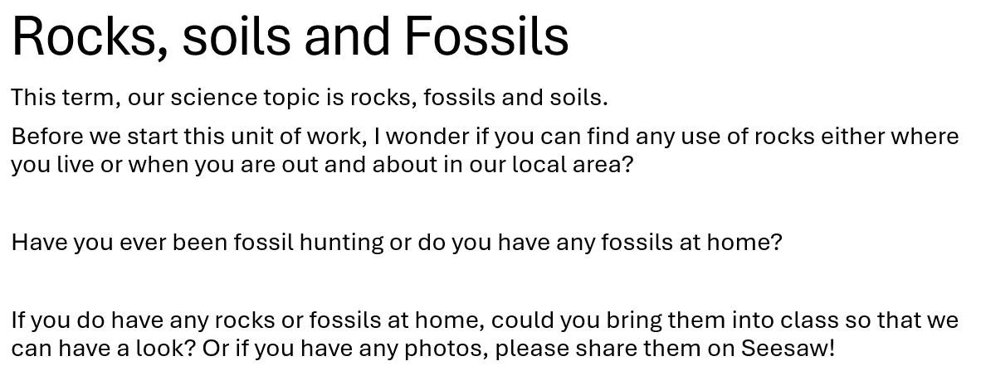
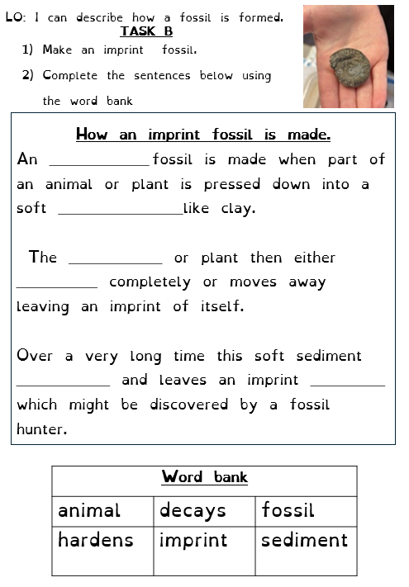
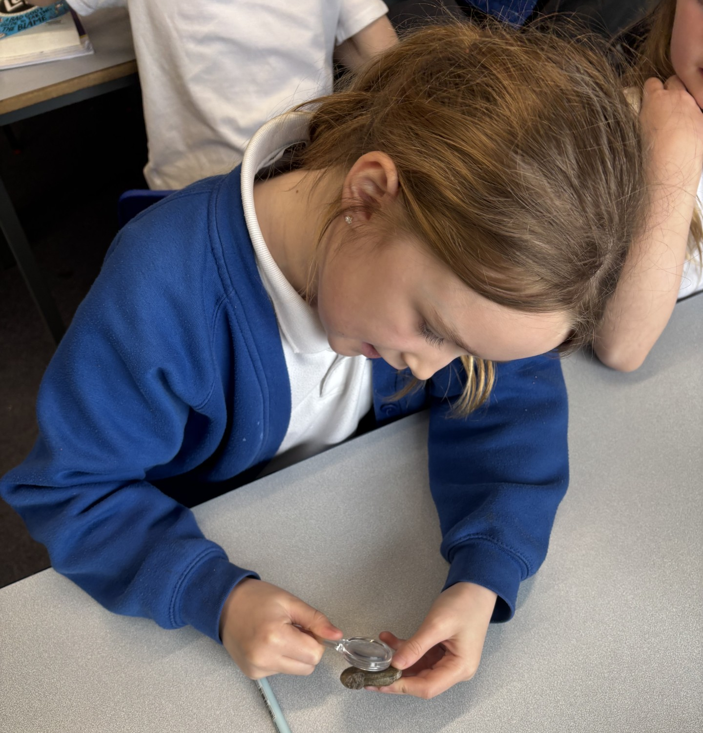
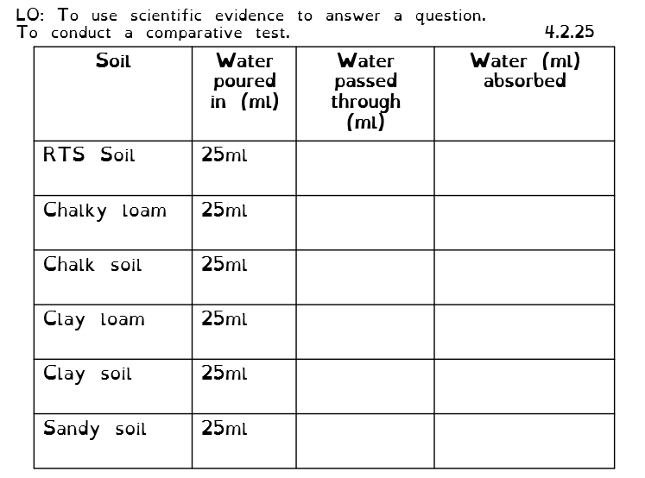
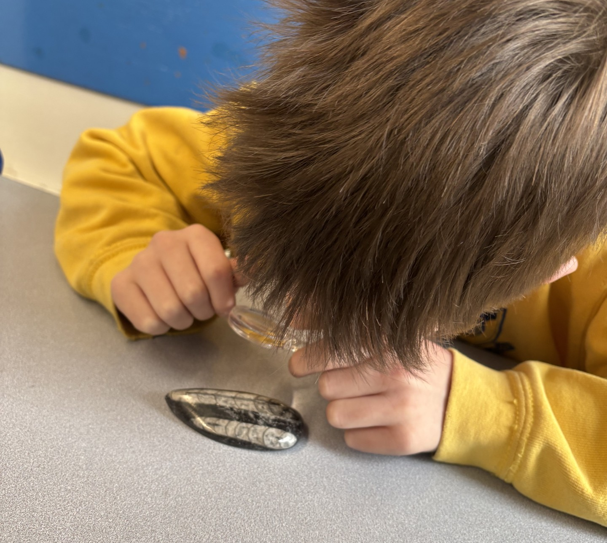
Nidderdale Class
Using the children’s photos in lesson slides and worksheets.
Pre topic task
Starting with the child to learn more about any prior knowledge/interests.
Personalising the learning to children’s interests.
Fostering inclusive teaching and learning –shared experience to find use of rocks at RTS.
Collecting soil from our school grounds to include in our comparative test.

Slide 9
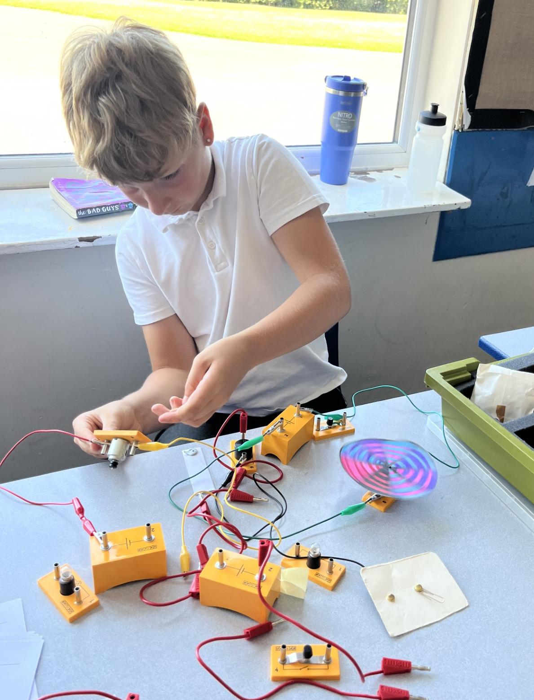
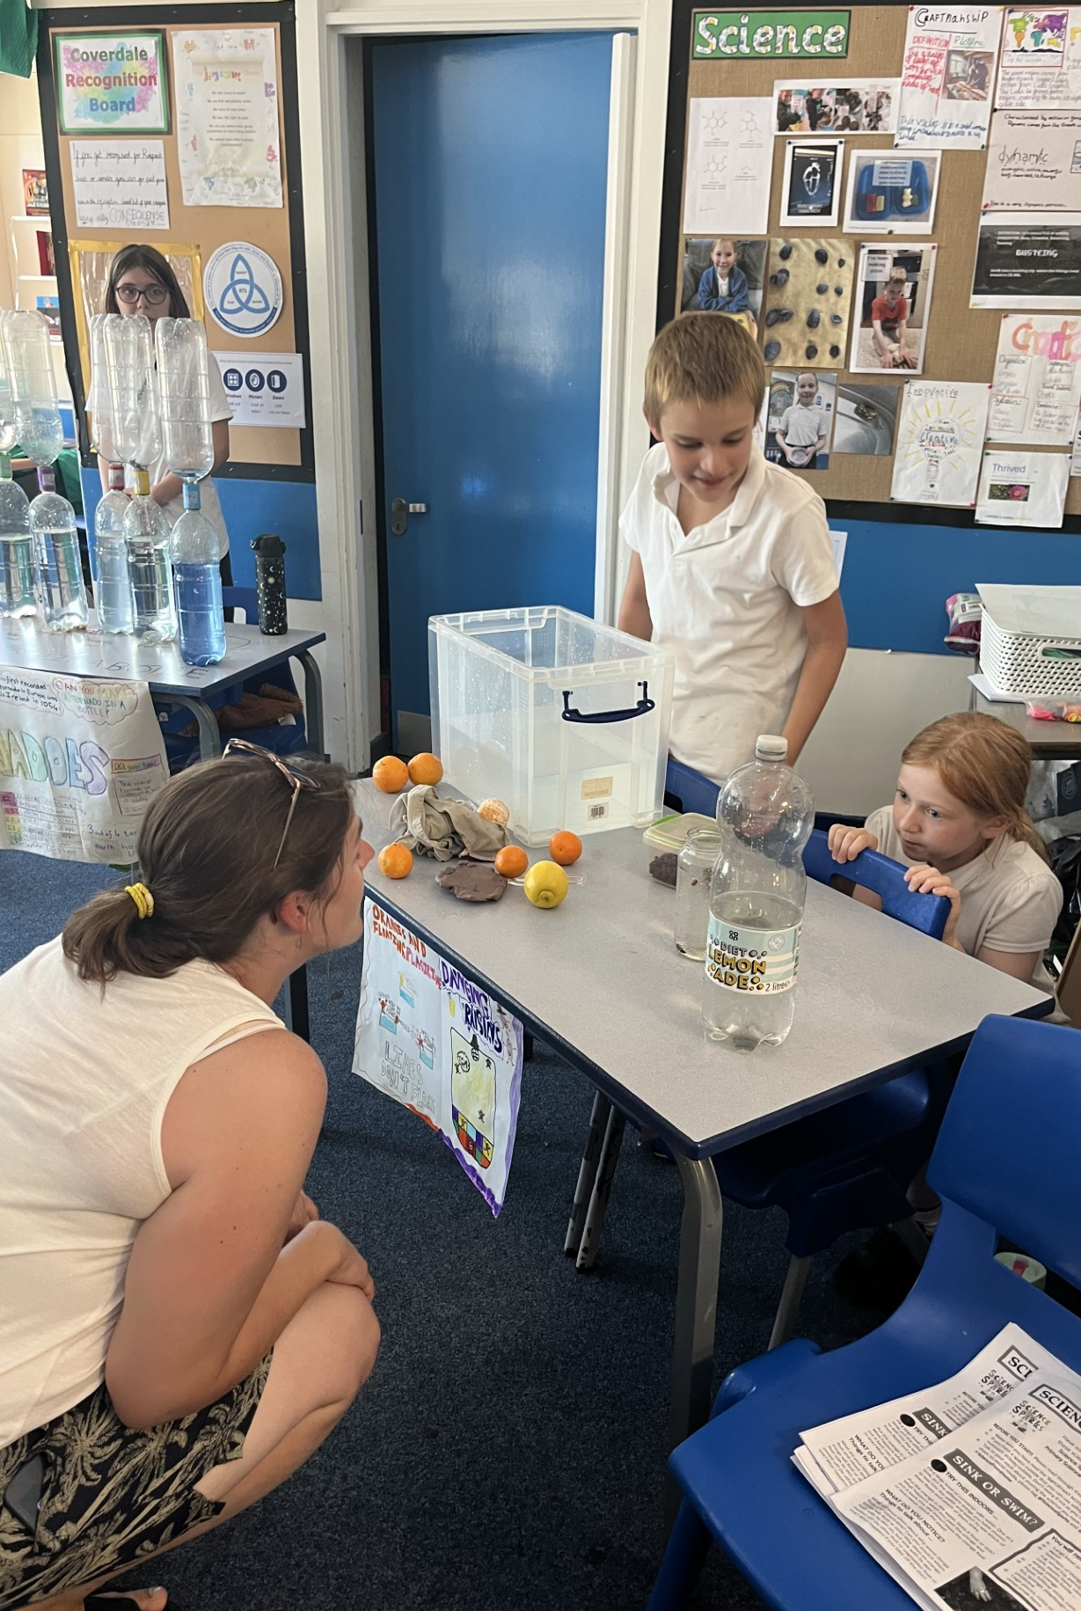
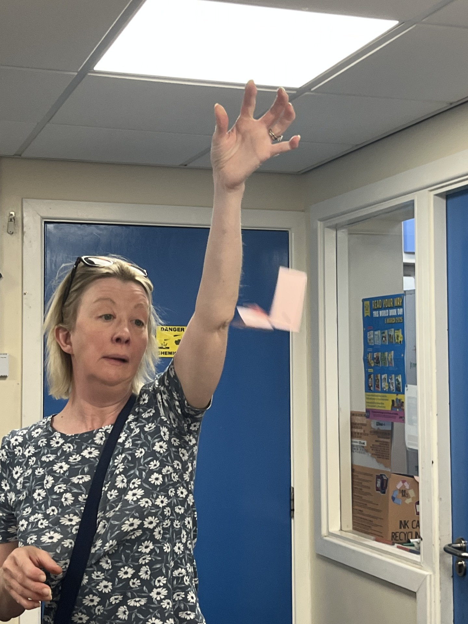
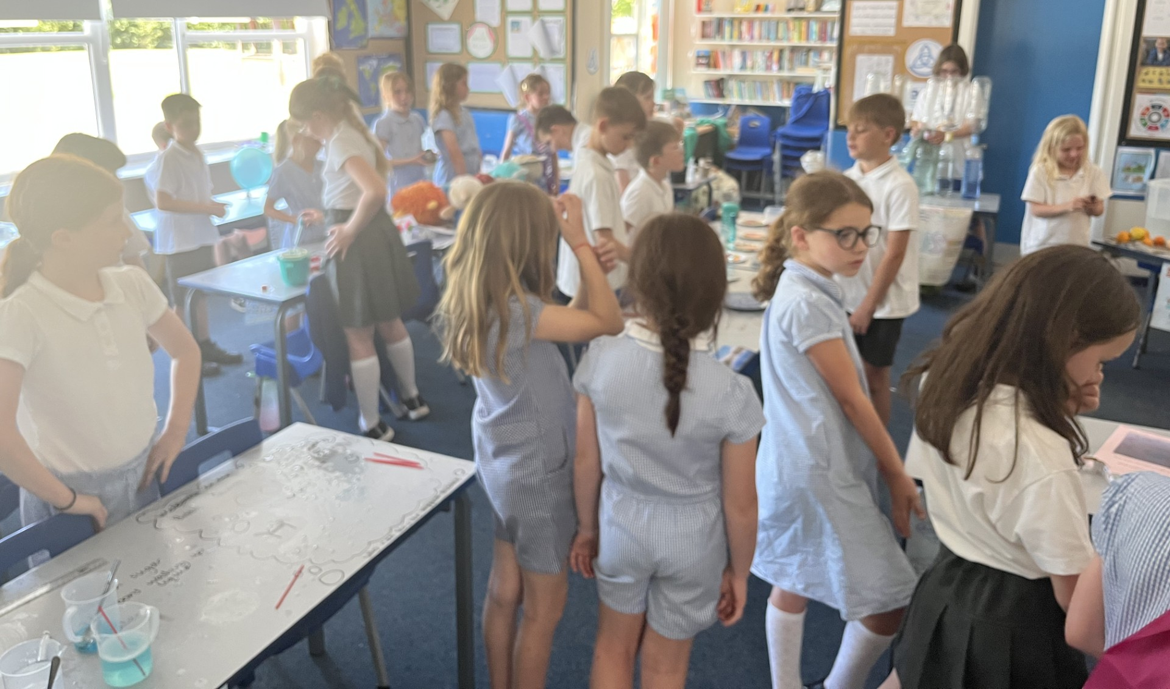
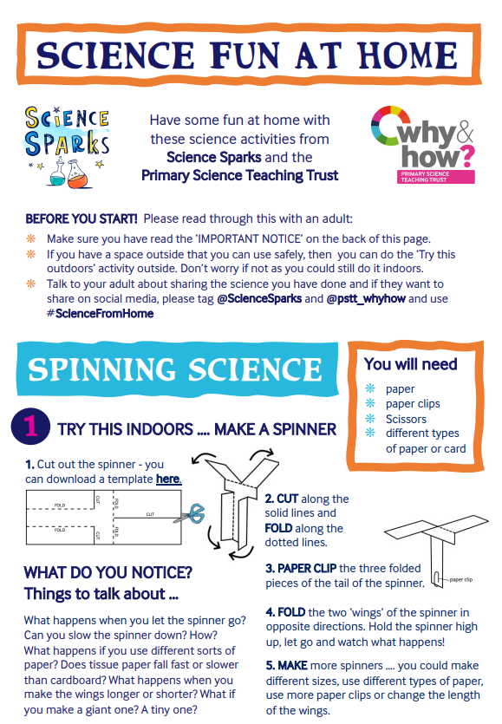
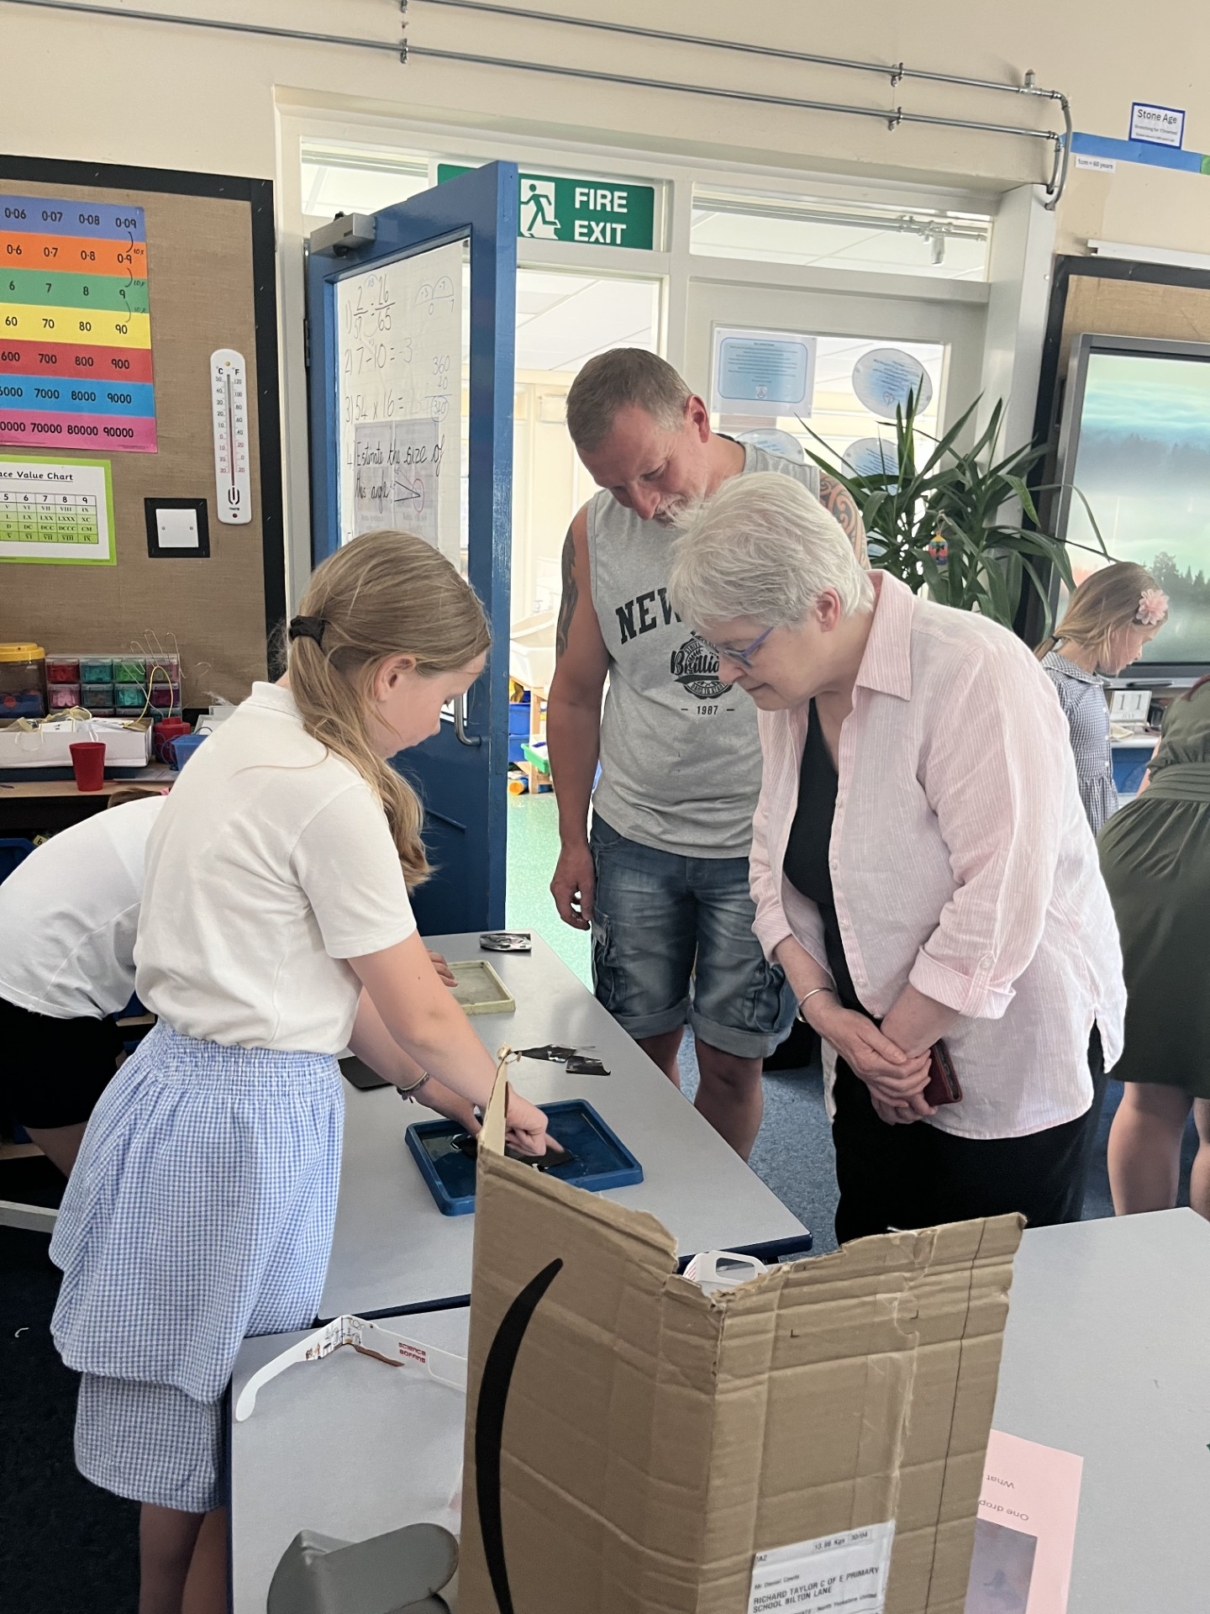
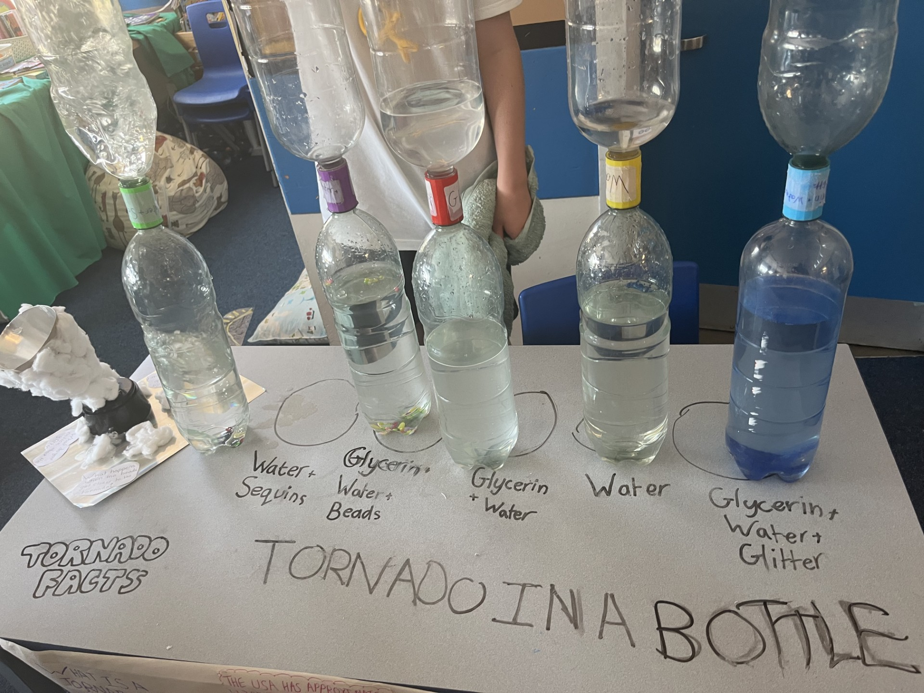
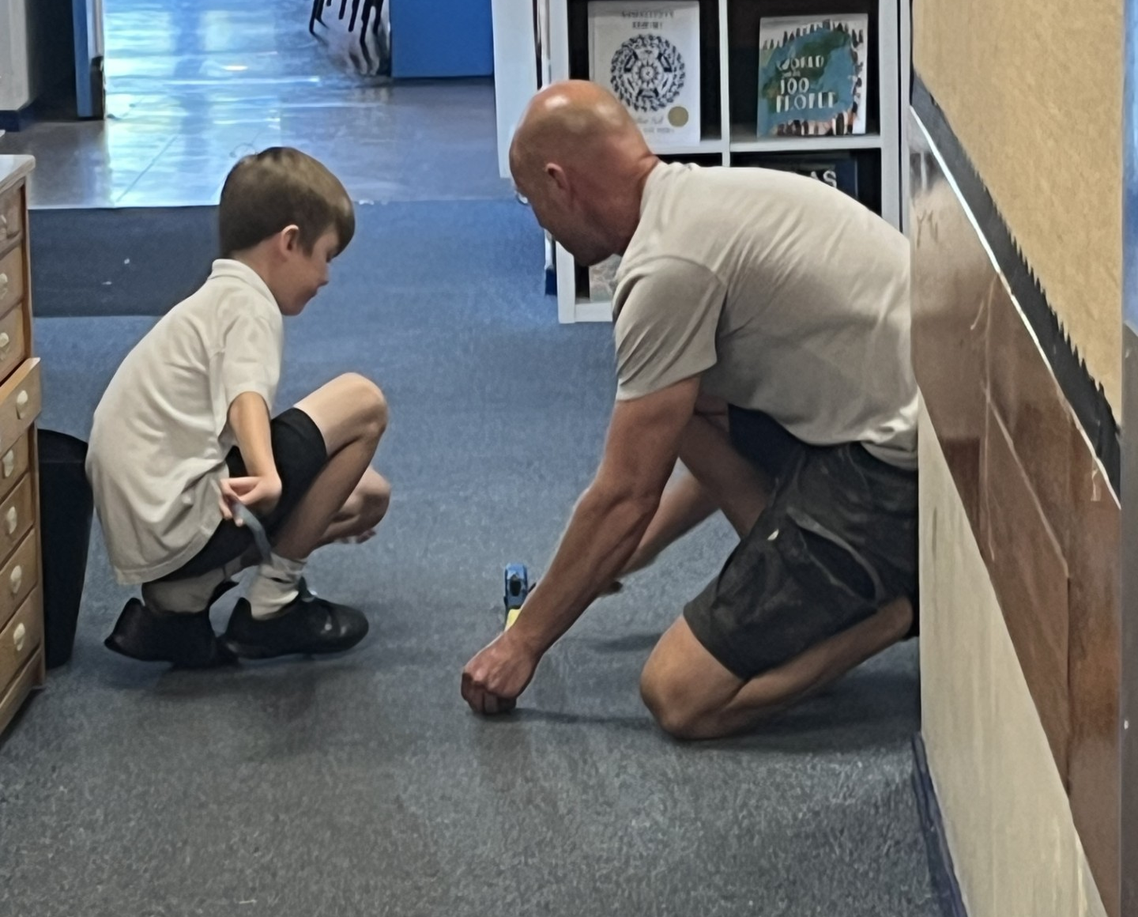
Coverdale Class
Science Busking
The event supported our focus on oracy. The children practised good quality talk and wrote key vocabulary and questions on their tables to support discussion with adults.
Children planned tasks to show common misconceptions
Competitions to engage parents
The children practised on other children before presenting to their families
Some children followed their own interests and worked with their families to bring an idea from home
Children demonstrated their learning from earlier in the year using Phizzi forces resources
Children made real life links e.g clear nail varnish on water to oil spill disasters.
Shared ideas for screen free science at home

Slide 10
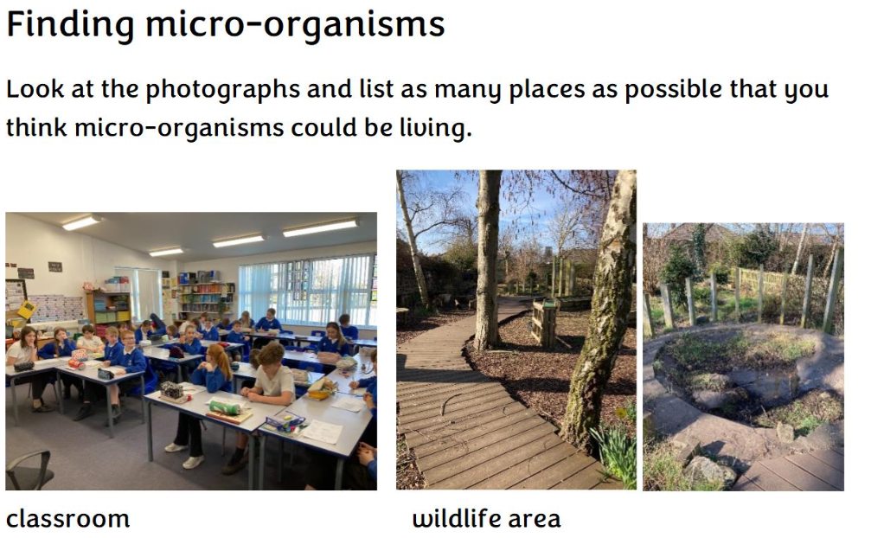
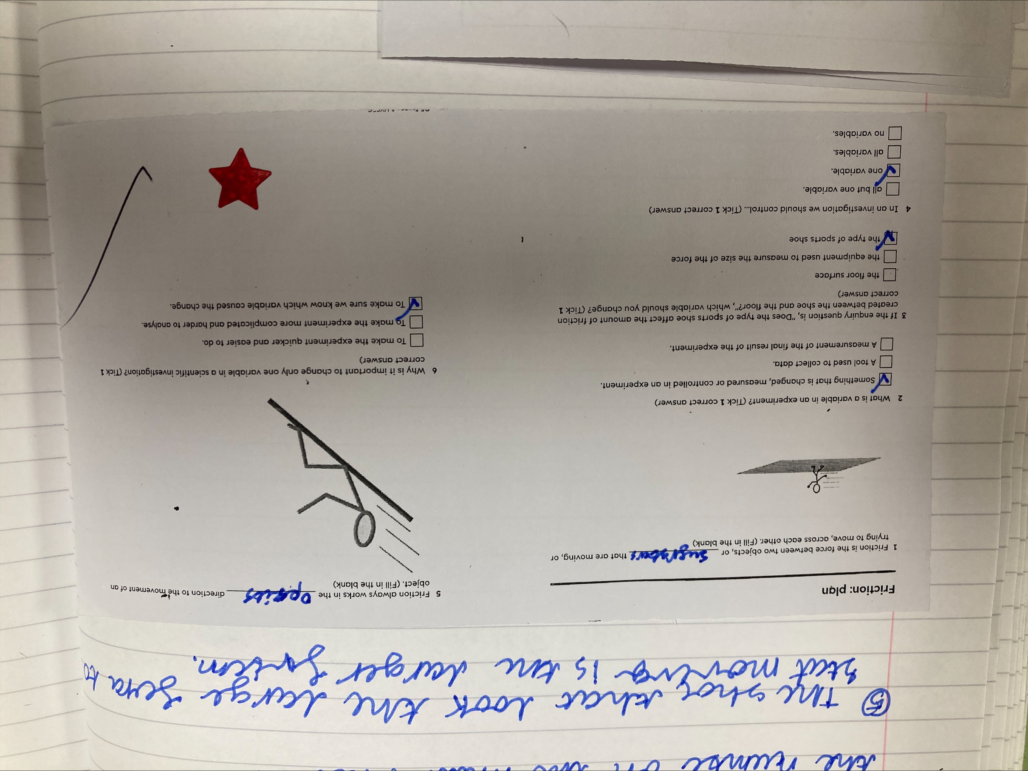
Wensleydale & Wharfedale Classes
Starting with the child - low stakes quizzes at the beginning of lessons to learn more about any prior knowledge/interests.
Personalise and Localise – Using our own classrooms and the school’s wildlife area with our worksheets instead of generic pictures

Slide 11
BASELINE Student Survey Summary
Summarise in three bullet points, the outcomes of your group discussion: (based on KS2 data)
1.Children at RTS enjoy Science
2. Fewer children know if they want to continue learning science
3. Children unsure or don’t think they are good at science

Slide 12
ENDLINE Student Survey Summary
Summarise in three bullet points, the outcomes of your endline survey with reference to your starting points
1. There is a slight increase in the number of children enjoying Science lessons but 54% are unsure about whether they want to continue learning science.
2. Children’s confidence with science has improved with 50% now saying they are good at science
3.Science is being spoken about more at home and children are beginning to recognise more jobs involving science.
Notes:
To complete after analysing your survey data in Session #1 Bedrock and Foundation of PSCTA

